Slide 1
Non-Contact AFM Metrology for Optical Force Measurements
ASU/NASA Space Grant 2018-2019
Garrett Rand and Dr. Liping Wang
Ira A. Fulton School of Engineering
April 13, 2019

Slide 2
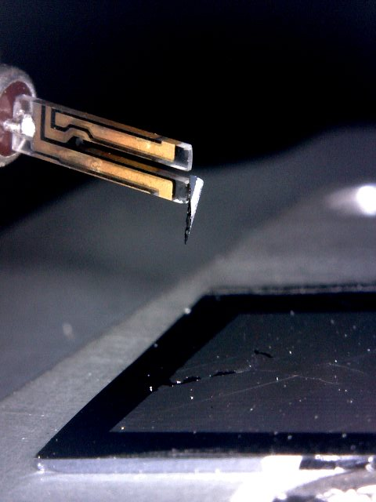
Overview
Optical Forces: an umbrella term describing short-range forces acting between two surfaces (e.g. Van der Waals, electrostatics, electromagnetism, Casimir Effect, and other distant-dependent forces)
Notes:
Overview of theory and science
Recently experimentally proven

Slide 3
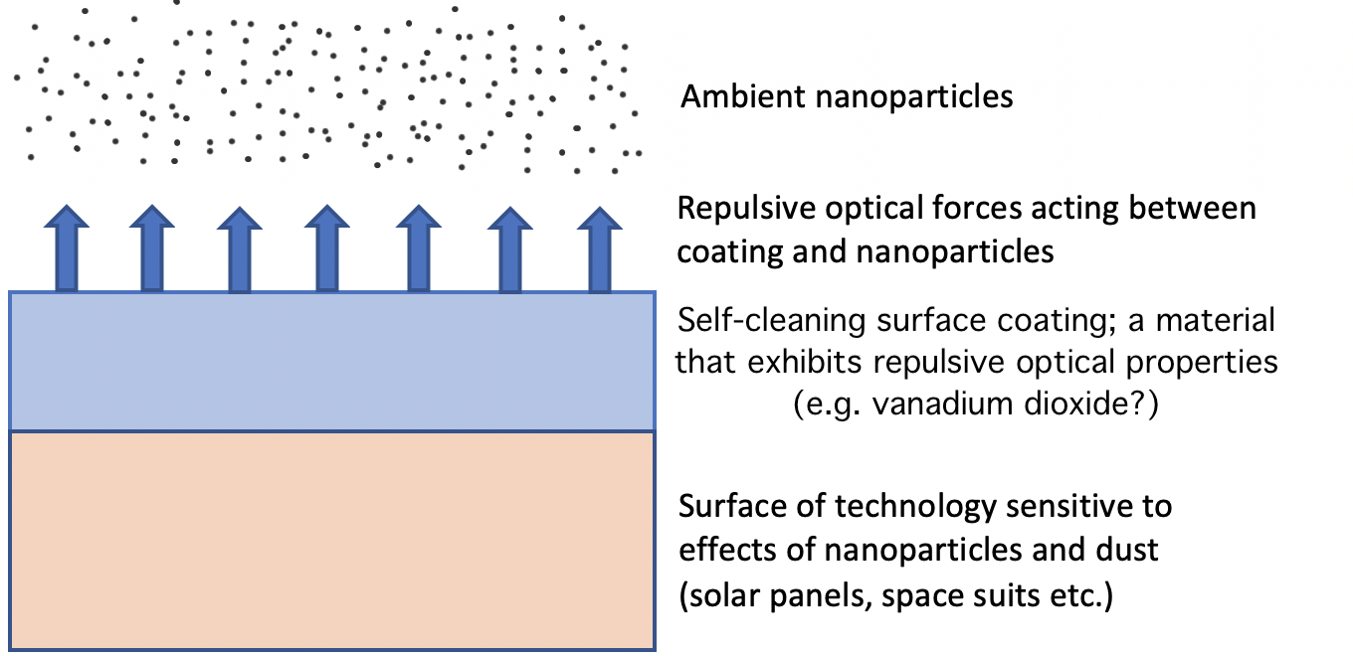
Applications
1) Self-cleaning surface coatings:
- Harness repulsive optical forces
to repel dust from solar panels
to increase longevity and
durability.
2) Nano-particle filtration systems:
- Repulsive mesh filters to decrease particles per cubic meter in cleanroom settings and to protect sensitive instruments, MEMS, etc.
3) Optical tweezers:
- A tool that isolates individual cells and molecules using repulsive and attractive optical forces

Slide 4
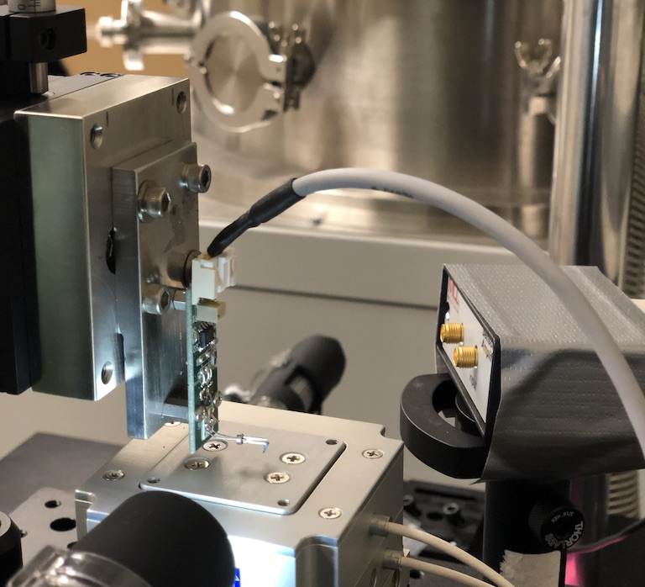
Objective
Develop a measurement system that will quantify the optical properties of different materials to a high degree of accuracy.
Notes:
objectives

Slide 5
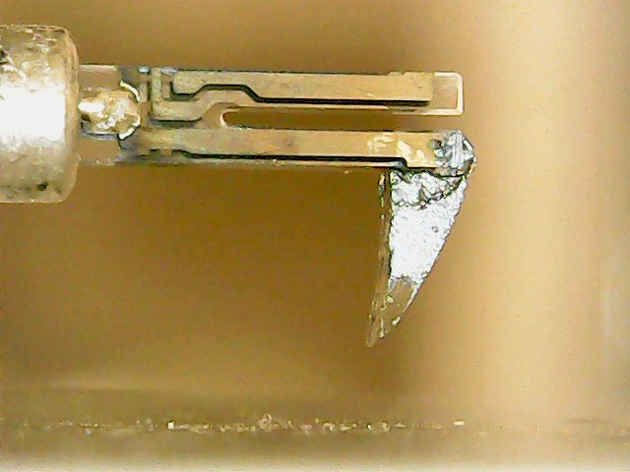
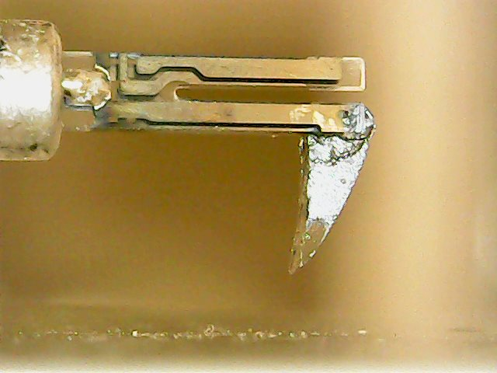
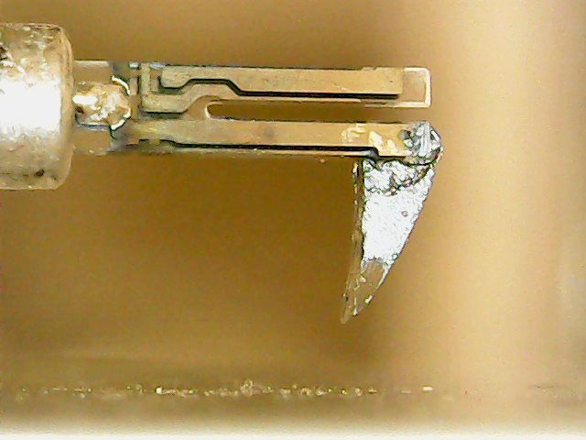
Tuning Fork Mechanism
0 µm (reference plane)
50 µm
100 µm
- Induce oscillations at resonance frequency in the sensor
- Raise sample towards probe
- Measure frequency before and after event of influence
- Difference in frequency is a function of force applied to the probe
Notes:
Nanopositioner

Slide 6
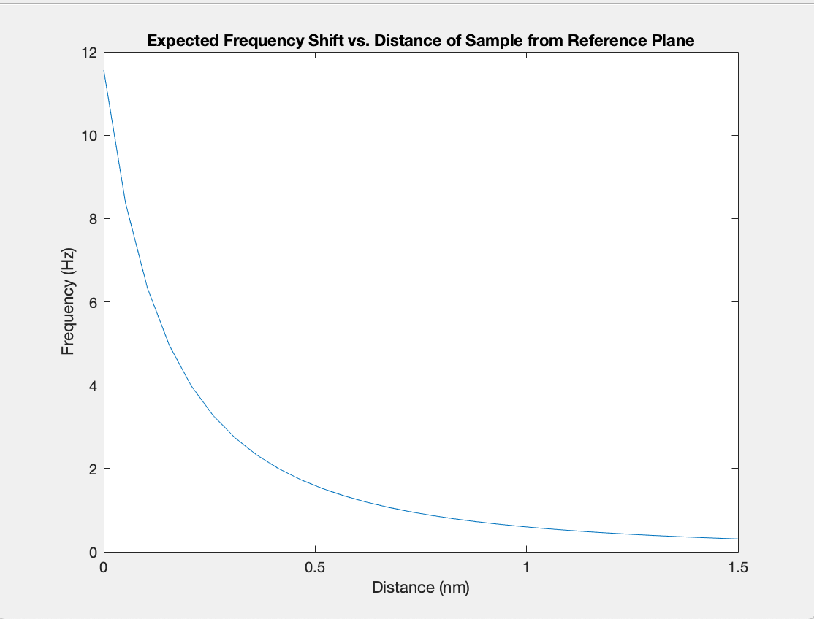

Expected Results
The curve begins at an initial machine-driven frequency. The sensor’s oscillations are dampened as the sample approaches the tip of the probe.
Frequency shift is related to the derivative of the force per unit distance applied to the sensor
Notes:
Interface between the tip and sample. This plot shows the distance increasing because it is in reference to the original starting point of the nano positioner.

Slide 7
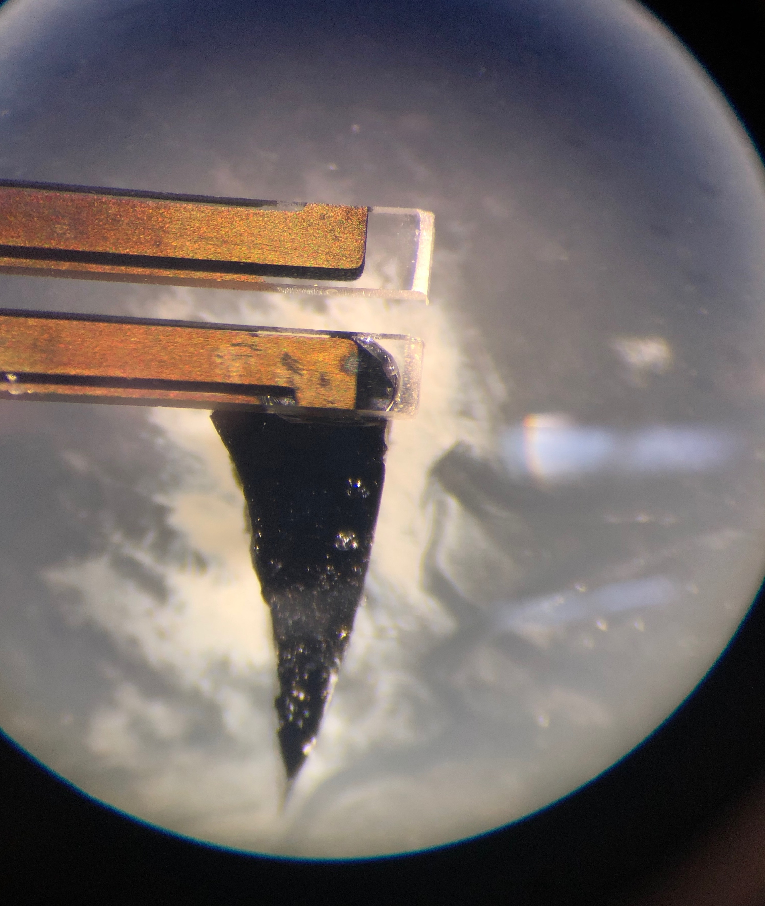
Challenges
Temperature regulation: the accuracy of the sensor depends on constant operating temperature
Ambient air, sound, vibrations, and radiation: any minute external influences will skew the data collected by the sensor
Precision: each prong is a few micrometers in length. Attaching a probe to a single prong requires great care

Slide 8
Future Work
Build repository of common materials and their respective optical properties (gold, silicon, dielectrics, semiconductors, etc.)
Modify experimental setup to account for conditions required to test tunable materials (VO₂, V₂O₅, Nb₂O₅)
Can tunable materials be used to modulate the strength or polarity of their optical forces?
Notes:
Vanadium dioxide, vanadium pentoxide, niobium pentoxide. And exploring more applications and uses for the technology

Slide 9
References
[1] T Ludwig. Casimir force experiments with quartz tuning forks and an atomic force microscope (AFM) 2008 J. Phys. A: Math. Theor. 41 164025
[2] Xiaoma Lu, Yiting Sun, Zhang Chen, & Yangfeng Gao. A multi-functional textile that combines self-cleaning, water-proofing and V02-based temperature-responsive thermoregulating. Solar Energy Materials & Solar Cells 159 (2017) 102–111
[3] Zhiping Mae, Wei Wang, Ying Liu, Linping Zhang, Hong Xu, Yi Zhong. Infrared stealth property based on semiconductor (M)-to-metallic(R) phase transition characteristics of W-doped V02 thin films coated on cotton fabrics. Thin Solid Films 558 (2014) 208–214
[4] J. N. Munday, Federico Capasso & V. Adrian Parsegian. Measured long-range repulsive Casimir–Lifshitz forces Nature 457 170–173 (2009)
[5] M.M. Qazilbash, M. Brehm, G.O. Andreev, A. Frenzel, P.-C. Ho, Byung-Gyo Chae, Bong- Jun Kim, Sun Jin Yun, Hyum-Tak Kim, A.V. Balatsky, O.G. Shpyrko, M.B. Maple, F. Keilmann, & D.N. Basov. Infrared spectroscopy and nano-imaging of the insulator-to-metal transition in vanadium dioxide. PHYSICAL REVIEW B 79, 075107 (2009)

Slide 10
Thank you
Questions?

